Slide 1

Deep learning for digital pathology image analysis:
A comprehensive tutorial with selected use cases
刘丽
18210240130

Slide 2
CONTENTS
J Pathol Inform
Introduction
1
3
Use Cases
4
Discussion
Digital Pathology
Tasks Address
2
5
Conclusion

Slide 3
J Pathol Inform
1
Introduction

Slide 4
1
Introduction
What is Digital pathology?
Digital pathology (DP) is the process by which histology slides are digitized to produce high-resolution images.
These digitized slides afford the possibility of applying image
analysis techniques to DP for applications in detection segmentation, and classification.

Slide 5
1
Introduction
The reason of selecting this paper
While DL approaches have performed well in a few DP related image analysis tasks, such as detection and tissue classification, the currently available open source tools and tutorials do not provide guidance on challenges such as
(a) selecting appropriate magnification,
(b) managing errors in annotations in the training (or learning) dataset,
(c) identifying a suitable training set containing information rich exemplars.

Slide 6
1
Introduction
Advantage:
Not only significantly reduce the laborious and tedious nature of providing accurate quantifications
But to act as a second reader helping to reduce inter-reader variability among pathologists

Slide 7
1
Introduction
Why is DL?
The DL approach involves deriving a suitable feature space solely from the data itself. This is a critical attribute of the DL family of methods, as learning from training exemplars allows for a pathway to generalization of the learned model to other independent test sets. Once the DL network has been trained with an adequately powered training set, it is usually able to generalize well to unseen situations, obviating the need of manually engineering features.

Slide 8
J Pathol Inform
2
Digital Pathology Tasks Address

Slide 9
2
Digital Pathology Task Address
Segmentation Detection Tasks
A segmentation task is defined as the requirement of delineating an accurate boundary for histologic primitives (i.e., nuclei, epithelium, tubules, and IDC)
Detection Tasks
the goal is typically to simply identify the center of the primitive of interest and not explicitly extract the primitive contour or boundary
Tissue‑Based Classification Task
Identifying individual tissue-based primitives (e.g., mitoses, nuclei) and trying to identify primitive specific features to make predictions regarding tissue class,

Slide 10
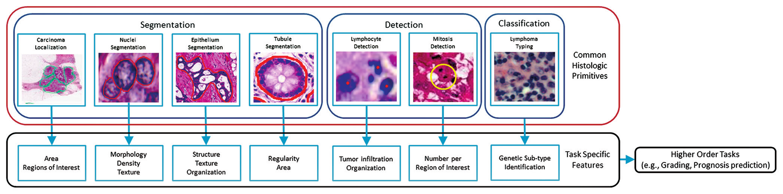
2
Digital Pathology Task Address

Slide 11
2
Digital Pathology Task Address
Manual Annotation for Ground Truth Generation
annotations are
(a) rarely pixel level precise,
(b) usually done at a lower magnification,
(c) tend to contain numerous false positives and negatives.

Slide 12
2
Digital Pathology Task Address
DEEP LEARNING METHODS
AlexNet
Caffe

Slide 13
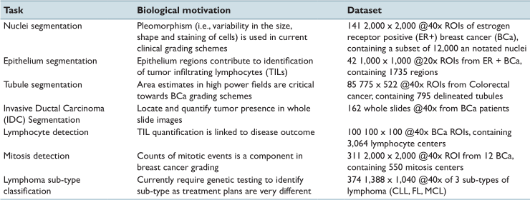
2
Digital Pathology Task Address
This table presents a list of the seven different tasks addressed in this paper.

Slide 14
J Pathol Inform
3
Use Cases

Slide 15
3
Use Cases
The clinical motivation
Unique challenges present in DP
Patch selection technique
Results and discussion

Slide 16
3
Use Cases - Nuclei Segmentation
Motivation
(a) There is evidence that the configuration of nuclei is correlated with outcome
(b) nuclear morphology is a key component in most cancer grading schemes.

Slide 17
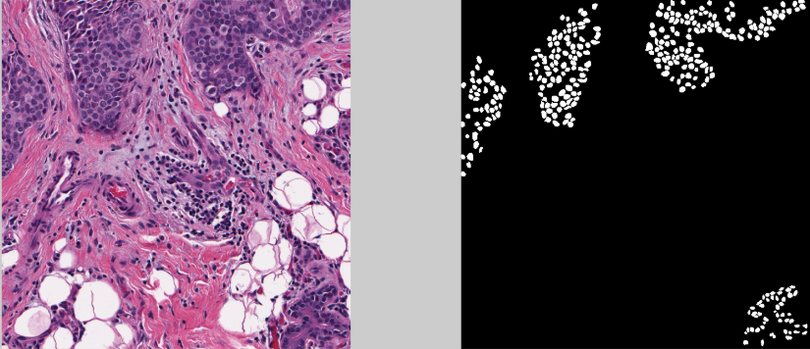
3
Use Cases - Nuclei Segmentation
Datasets : We have specifically chosen to look at the problem of detecting nuclei within hematoxylin and eosin (H&E) stained estrogen receptor positive (ER+) breast cancer images.

Slide 18
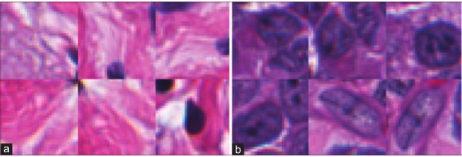
3
Use Cases - Nuclei Segmentation
Patch selection technique
Standard apporach:
selecting patches from the positive class
using a threshold on the color-deconvolved image to determine examples of the negative class
(a) the negative class show large areas of stroma which are notably different than
(b) the positive nuclei class and tend to be very easily classified.

Slide 19
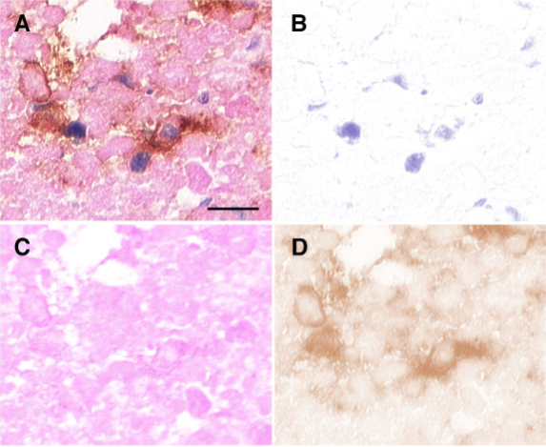
3
Use Cases - Nuclei Segmentation
color-deconvolved image
The present method of color deconvolution allows the separate presentation of stain components
(A) Photomicrograph of a breast tissue slide that is stained with DAB (brown), hematoxylin (blue) and eosin (magenta). (B-D) Color-deconvolution results separating the contributions of hematoxylin (B), eosin (C) and DAB (D) to the original image.

Slide 20
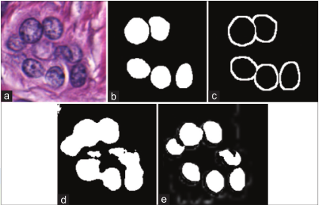
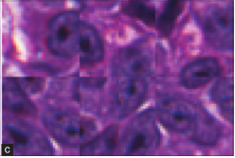
3
Use Cases - Nuclei Segmentation
Result : the network is unable to accurately identify nuclear boundaries
Reason : these edges are underrepresented in the training set
To enhance these boundaries, an edge mask is produced by morphological dilation of b

Slide 21
3
Use Cases - Nuclei Segmentation
Each of the 5-folds in the cross-validation set had about 100 training and 28 testing images.
We use a ratio of 1:1:0.3 in selecting positive patches, negative edge patches, and miscellaneous negative patches
total :130 k patches in the training set

Slide 22
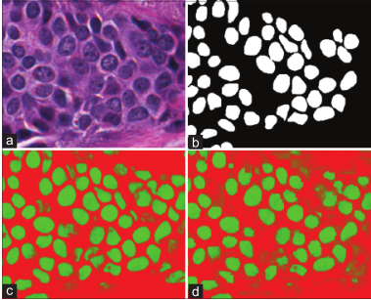
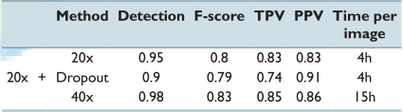
3
Use Cases - Nuclei Segmentation
Results and Discussions
For the detection rate:F-scores,TPR,PPV
Quantitatively
Qualitatively

Slide 23
3
Use Cases - Epithelium Segmentation
Motivation
The identification of epithelium and stroma regions is important since regions of cancer are typically manifested in the epithelium.
histologic patterns within the stroma might be critical in predicting overall survival and outcome in breast cancer patients
Unique: typically done more abstractly by experts at lower magnifications

Slide 24
3
Use Cases - Epithelium Segmentation
Patch selection technique
The general principal employed is that a human expert should be able to make an educated decision based solely on the context present in the patch supplied to the DL network.
Each of the 5-fold cross validation sets has about 34 training images and 8 test images.
We use a ratio of 5:5:1.5 in selecting positive patches, negative edge patches, and miscellaneous negative patches total of 765 k patches in the training set.
select an appropriate magnification

Slide 25
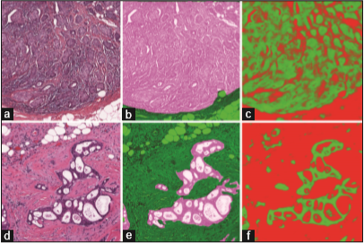
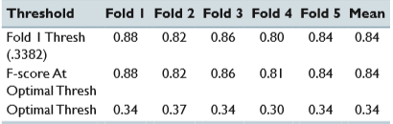
3
Use Cases - Epithelium Segmentation
Results and Discussion
our results appear quite similar to the original ground truth, the additional pixel level detail that the DL segmentation yields are not quite captured by the quantitative metrics,
a 、d original images
b 、e ground truth
c 、 f the results from the deep learning

Slide 26
3
Use Cases - Lymphocyte Detection
Motivation
Lymphocytes, a subtype of white blood cells, are an important part of the immune system
Goal : identify the center of lymphocytes, making this a detection problem

Slide 27
3
Use Cases - Lymphocyte Detection
Patch selection technique
original ×40 magnification
lymphocyte is approximately 10 pixels in diameter
resize the images to be ×4 as large,
Why naïve Bayesian classifier?
This approach further helps us to bootstrap our training set, by removing trivial samples, without requiring any additional domain knowledge.
Positive class
Negative class
a naïve Bayesian classifier is trained on 1000 randomly selected pixels from the image to generate posterior class membership probabilities for all pixels in the image,
for all false positive errors, the distance between the false positive pixels and the closest true positive pixels is computed
iteratively, the pixel with the greatest distance between the false positive and true positive errors is chosen so that negative image patches can be generated from those locations.

Slide 28
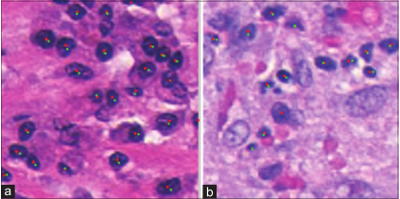
3
Use Cases - Lymphocyte Detection
Results and discussion
The mean F-score 0.90 ± 0.01
mean TPR 0.93 ± 0.01
mean PPV of 0.87 ± 0.02
green dots are the ground truth
red dots are the centers discovered by the algorithm.

Slide 29
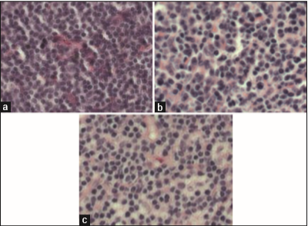
3
Use Cases - Lymphoma Subtype Classification
challenge
three sub-types of lymphoma:
Chronic lymphocytic leukemia (CLL)
follicular lymphoma (FL)
mantle cell lymphoma (MCL).
In the previous tasks, we were looking at primitives and attempting to segmented or detect them. In this case, though, a high-level approach is taken, wherein we provide whole tissue samples to have the DL learn unique features of each class.

Slide 30
3
Use Cases - Lymphoma Subtype Classification
Patch selection technique
To generate training patches, a naïve approach was used.
split into 36 × 36 sub-patches
crop out smaller 32 × 32 patches

Slide 31
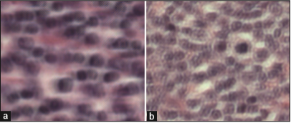
3
Use Cases - Lymphocyte Detection
Results and discussion
The mean accuracy is 96.58% ±0.01%
In the cases where images were incorrectly classified, there tends to be an overall poor quality of the slide

Slide 32
J Pathol Inform
5
Discussion

Slide 33
2
Digital Pathology Task Address
A few insights:
First, there was no situation which dropout had improved the resulting metrics.
Second, it is of the utmost importance to select an appropriate magnification for each task
Third, a majority of the work in this paper focused on finding simple, albeit robust ways of identifying challenging exemplars that would be most informative to the DL network
In addition, approaches such as blue-ratio segmentation or color deconvolution could serve as a preprocessing step to identify locations for subsequent application of a DL network, for instance in the detection of nuclei.

Slide 34
J Pathol Inform
6
Inconclusion

Slide 35
2
Inconclusion
What can we learn from this paper?
hematoxylin-eosin staining
The skills of sampling patches
Color-deconvolution

Slide 36
J Pathol Inform
THANK YOU FOR LISTENING

